Slide 1
QnA
Freshman Seminar
2022.03.02.
Sumin Sohn

Slide 2
The Meaning of Maximum Jitter
Network jitter
The delay between two successive packets
Guaranteed Maximum jitter
The delay between two successive packets is no larger than maximum delay

Slide 3
ATM CBR
Asynchronous Transfer Mode
Telecommunications standard for digital transmission
ATM uses connection-oriented model
Establish a virtual circuit
It maps physical, link, network layers
All ATM packets are the same small size
Constant Bit Rate
One of the services ATM provides
Maximum transmission rate is specified as constant
Making a packets flowing pipe

Slide 4
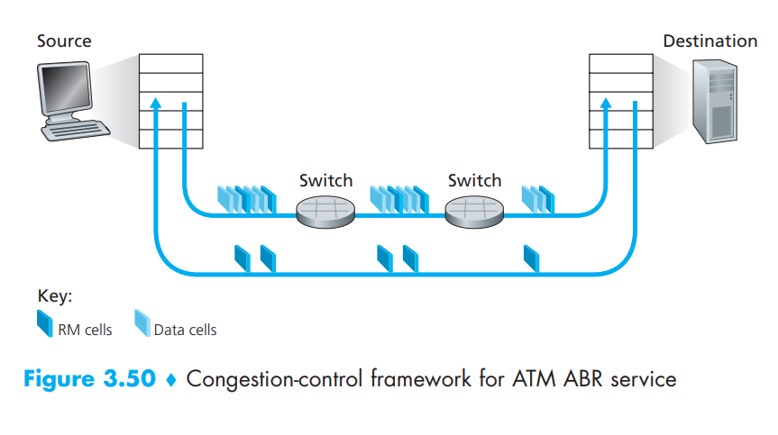
ATM ABR
Congestion control is provided
Bit rate is changed according to the information in the RM cell
RM cell
Congestion information included

Slide 5
Private Addresses
IP Address Range | Number of Addresses
10.0.0.0 – 10.255.255.255 | 16777216
172.16.0.0 – 172.31.255.255 | 1048576
192.168.0.0 – 192.168.255.255 | 65536

Slide 6
Classful Addressing
At first, 5 Classes are defined
Lack of IPv4 addresses
Class C has 8 bit address for assigned address
Classless Addressing
Subnet has variable range
Deficiency of address is solved
CLASS | Leading Bits | Starting Address | Ending Address
Class A | 0 | 0.0.0.0 | 127.255.255.255
Class B | 10 | 128.0.0.0 | 191.255.255.255
Class C | 110 | 192.0.0.0 | 223.255.255.255
Class D (Multicast) | 1110 | 224.0.0.0 | 239.255.255.255
Class E (Reserved) | 1111 | 240.0.0.0 | 255.255.255.255

